Slide 1


4 W Canvas

Slide 2


Topic - Diabetes
Diabetes mellitus, commonly referred to simply as diabetes, is a metabolic disease that causes high blood sugar.
The hormone insulin moves sugar from the blood into your cells to be stored or used for energy. With diabetes, your body either doesn’t make enough insulin or can’t effectively use the insulin it does make.
Untreated high blood sugar from diabetes can damage your nerves, eyes, kidneys, and other organs. But educating yourself about diabetes and taking steps to prevent or manage it can help you protect your health.

Slide 3

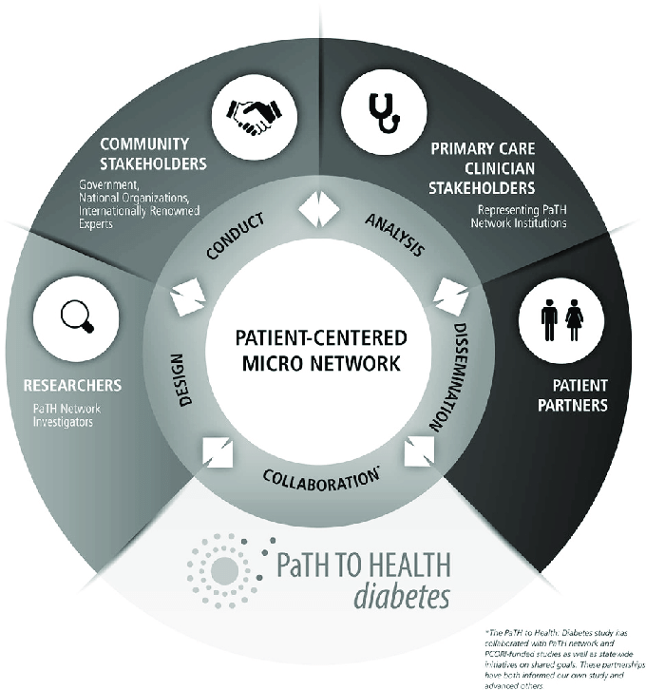
Who ? The stakeholders
In diabetes the main stakeholders are Patients, Providers (professionals and institutions), Payors, and Policymakers ('The four Ps' in healthcare). Moreover, industry (e.g. medical device, pharmaceutical, biotechnology), regulators, research community, and media are also important.

Slide 4
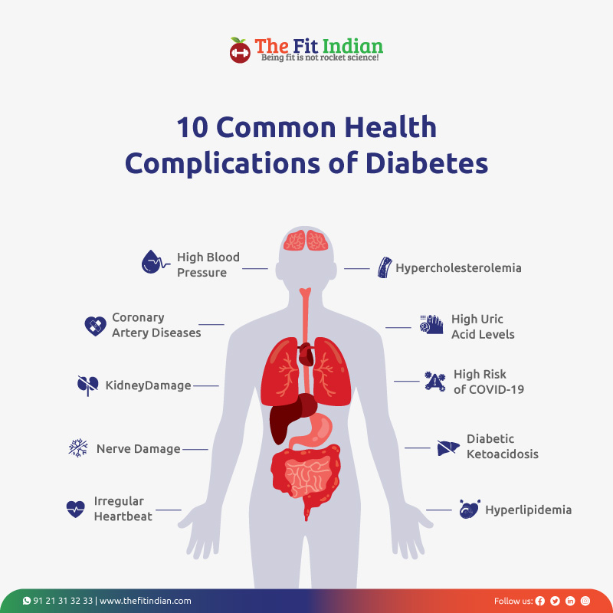
What ? The Problem
Diabetes majorly increases the risk of many heart problems. These can include coronary artery disease with chest pain (angina), heart attack, stroke and narrowing of arteries (atherosclerosis). If you have diabetes, you're more likely to have heart disease or stroke. Nerve damage (neuropathy). People are not able to identify the stages that are before diabetes and hence cannot stop themselves from controlling their blood sugar level

Slide 5
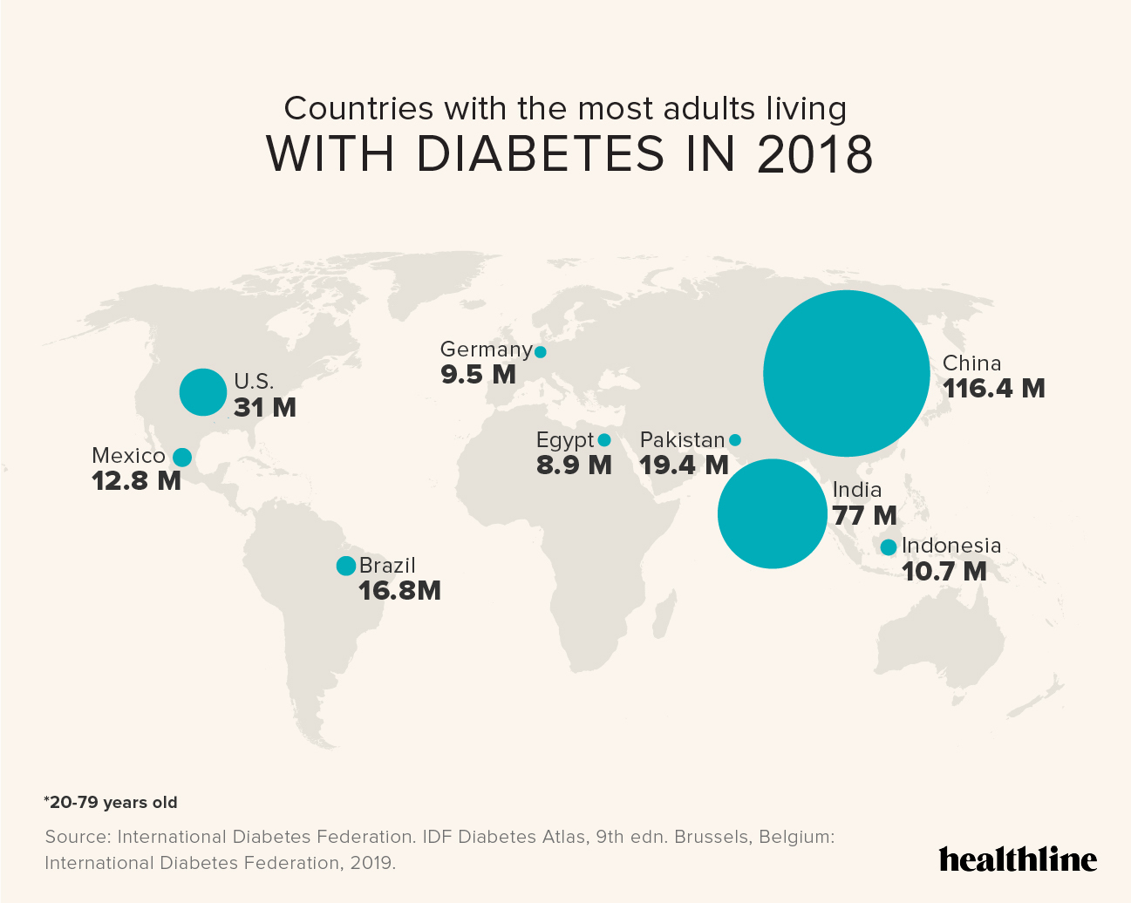
Where ? The statistics
Approximately 537 million adults (20-79 years) are living with diabetes.
The total number of people living with diabetes is projected to rise to 643 million by 2030 and 783 million by 2045.
3 in 4 adults with diabetes live in low- and middle-income countries
Almost 1 in 2 (240 million) adults living with diabetes are undiagnosed
Diabetes caused 6.7 million deaths Diabetes caused at least USD 966 billion dollars in health expenditure – 9% of total spending on adults
More than 1.2 million children and adolescents (0-19 years) are living with type 1 diabetes
1 in 6 live births (21 million) are affected by diabetes during pregnancy 541 million adults are at increased risk of developing type 2 diabetes

Slide 6
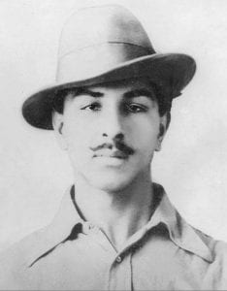
Bhagat Singh
Born in 1907, Bhagat Singh was among the extreme revolutionary Indian freedom fighters. He was a largely controversial, though respected figure in the freedom struggle of India. This revolutionary hero was born in a Sikh family in the undivided state of Punjab and carried the legacy of his family and clinched to his patriotism till his death. He was involved in a plot in 1928 to assassinate James Scott, a British police superintendent to exact revenge for the death of Lala Lajpat Rai. The plot failed when they mistakenly killed another young police officer and Singh fled to Lahore to escape from punishment. The following year, he, along with his associates hurled a bomb at the Central Legislative Assembly in Delhi in protest against the implementation of the Defence of India Act and surrendered to the police. This great Indian freedom fighter was sentenced to death by hanging by the British, and executed at the age of only 23.

Slide 7
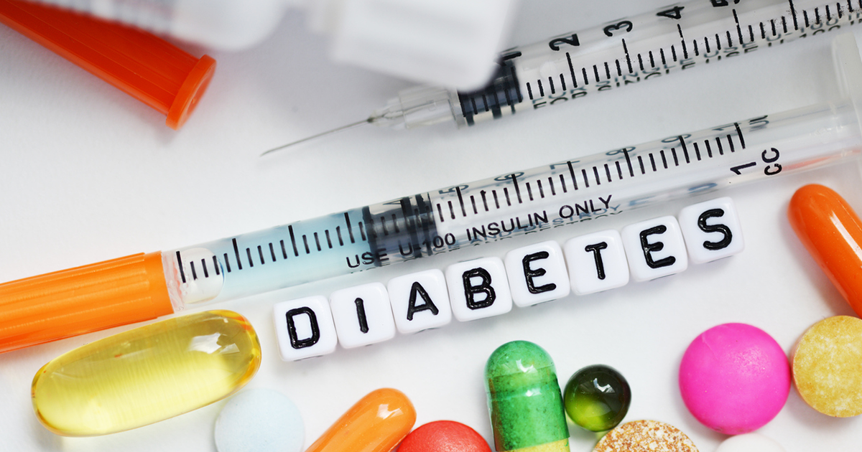
Why ? The reason
Despite its huge impact on the global population, there is still no cure for any type of diabetes. Most treatments help patients manage the symptoms to a certain extent, but diabetics still face multiple long-term health complications.
Diabetes is the major cause of blindness, kidney failure, heart attack, and stroke. It is estimated that the number of people affected by diabetes will rise to 700 million by 2045. This has led the World Health Organization to consider diabetes an epidemic.
Since we cannot find a way to cure diabetes we can surely use Machine Learning and Artificial Intelligence to atleast predict and prevent diabetes

Slide 8


The solution – A trained ML diabetes model

Slide 9

Algorithm used

Slide 10
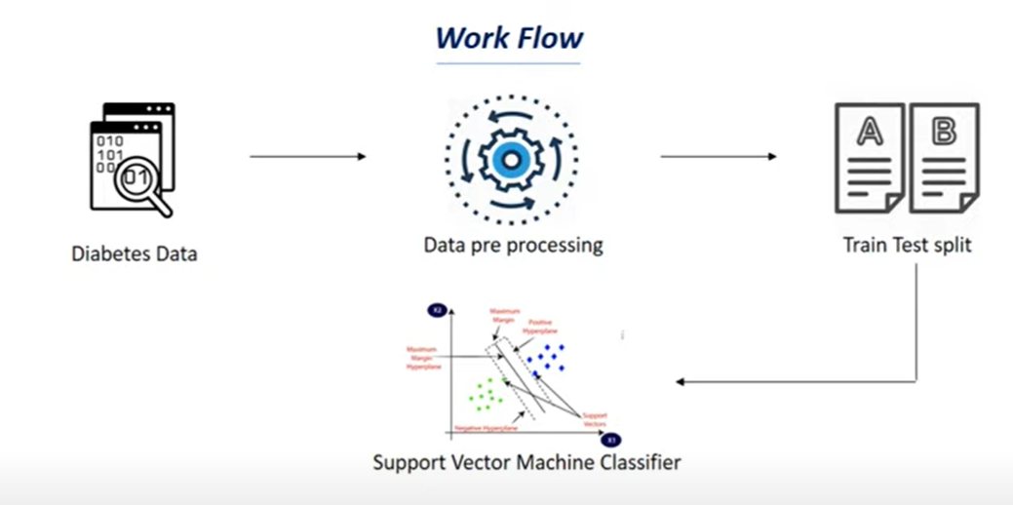

Slide 11
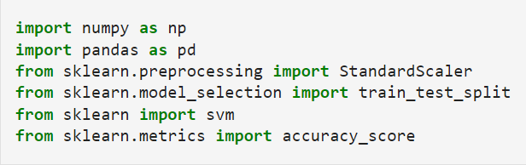
Modules used

Slide 12
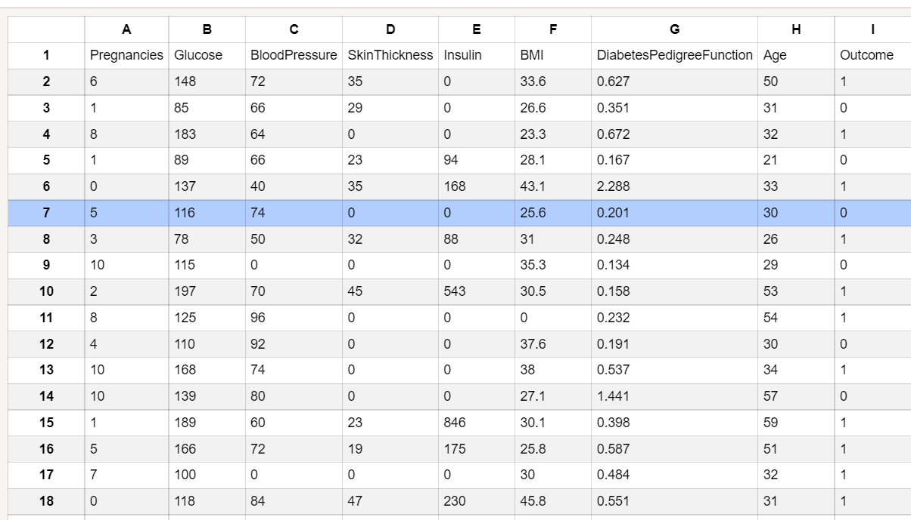
Demo DATA

Slide 13


